Slide 1
eQuest’s OFCCP Compliance & Diversity Solutions
Audit Protection

Slide 2
eQuest Compliance Overview:
OFCCP Regulations
eQuest Posting Interface
Posting Process
Audit Support & Reporting

Slide 3
OFCCP Regulations
Executive Order 11246, as amended 41 Code of Federal Regulations, Part 60
  Prohibits discrimination in hiring or employment decisions on the basis of race, color, gender, religion, and national origin.
  Requires Good Faith Effort to ensure equal employment opportunity.
Section 503 of the Rehabilitation Act of 1973, as amended 41 Code of Federal Regulations, Part 60, 60-741
  Prohibits discrimination and requires equal employment opportunity in all personnel practices for qualified individuals with disabilities.
The Vietnam Era Veterans Readjustment Assistance Act of 1974, as amended (VEVRAA) 41 Code of Federal Regulations, Part 60 60-250 and 300
  Prohibits discrimination and requires equal employment opportunity in all personnel practices for special disabled veterans, Vietnam Era veterans, and other protected veterans.
  Requires that jobs be listed at the local American Job Center (known also as the employment service delivery system) where the openings occur.

Slide 4
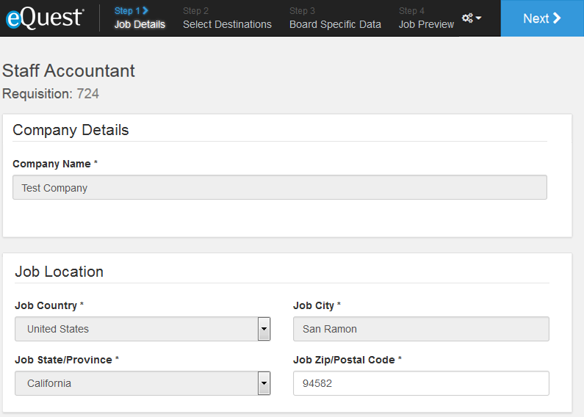
eQuest Job Posting Interface

Slide 5
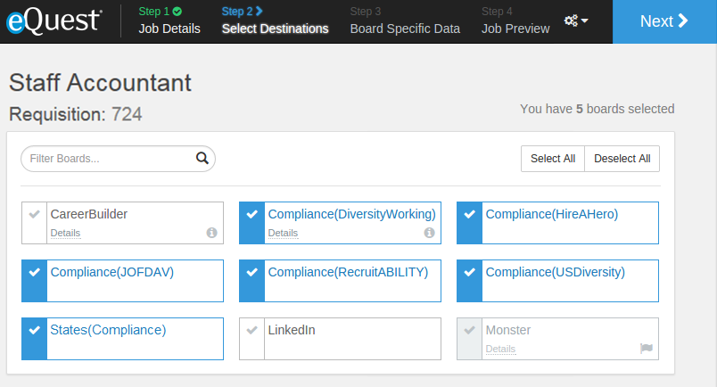
eQuest Job Posting Interface

Slide 6
What eQuest Does With Job
Listed at the local American Job Center
  Known also as the Employment Service Delivery System or ESDS, jobs go directly to the local offices and desks of many Employment Development Representatives for workforce development in compliance with VEEVRAA.
Sent via job feed to Diversity Boards
  Boards are tailored to fit OFCCP guidelines on minority, disability and veteran hiring.
Sent via email to Local Outreach Contacts.
  Non-profits, colleges/vocational institutions and local career centers within a 50 mile radius of the posting zip code.

Slide 7
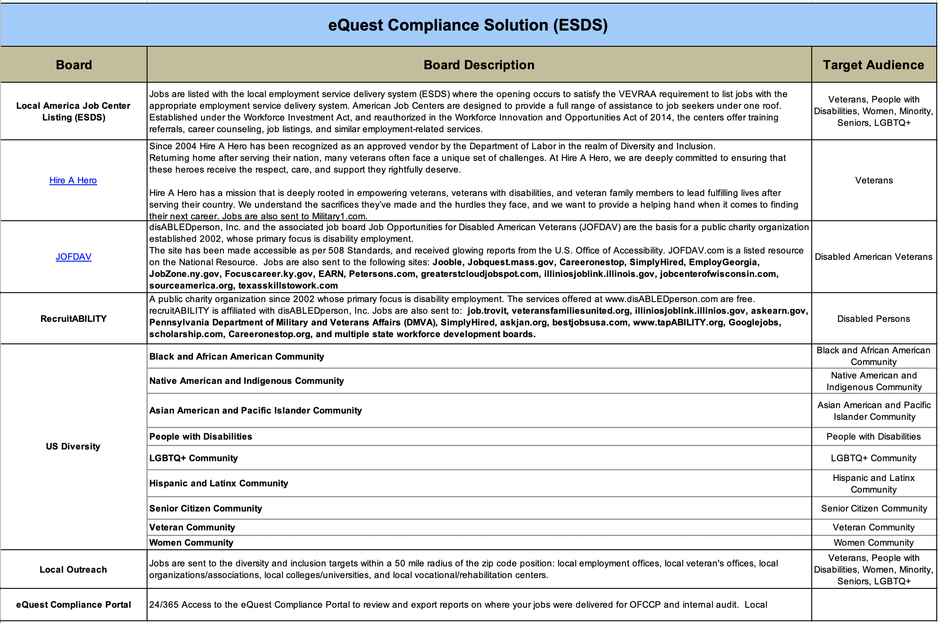
eQuest Job Posting Interface

Slide 8

Contact Information
Maurice Dowdell
eQuest Compliance
T: 925.275-2417|F: 925.275.3102
E: maurice @equest.com

